Slide 1


IT TICKET ANALYSIS
DIVYANSHI JAIN
22/9/2025

Slide 2
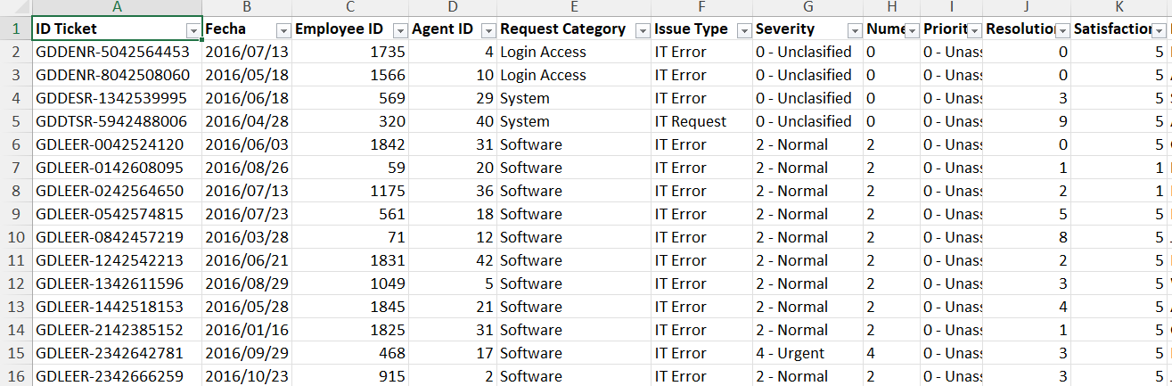
Problem Statement
The objective is to analyze the IT support ticket management system to understand the performance of IT agents, the efficiency of ticket resolution, and the satisfaction levels of employees. The analysis aims to identify high and low performers among IT agents, assess the overall effectiveness of the team, and pinpoint areas for improvement in the ticket resolution process. The ultimate goal is to make informed staffing decisions, including hiring, firing, and training, to enhance overall service quality and team performance.

Slide 3

ABOUT THE IT TICKET ANALYSIS
IT ticket analysis focuses on streamlining and optimizing IT services to the employees.
Key Objectives :
Ticket Categorization :
Analyze ticket types, priority levels and type of issue involved
Root Cause Analysis :
Identify recurring issues and propose long-term solutions
Performance Metrics :
Monitor resolution times, workload distribution and SLA compliance.

Slide 4

DATA OVERVIEW
Ticket ID : Unique identifier for each ticket
Date : Date of creation of the ticket
Agent ID : Unique identifier for agents
Employee ID : Unique identifier for employees who raised the ticket
Priority : Levels such as Low, Medium, High
Type : Such as Login Access or Login Request
Category : Hardware, Software, System etc
Resolution time : Time taken to resolve the issue
Satisfaction Rating : Ratings given by employees based on their satisfaction level

Slide 5

Data cleaning steps undertaken
Changed the format of date column to YYYY-MMM-DD format in the tickets sheet.
Used the date function to obtain the DOB of agents in IT agents sheet.
Calculated the age of the employees in IT agents sheet
Found for duplicate entries, but no duplicates values found.

Slide 6

WHY is the DATA crucial ???
It helps us understand the Severity level of the ticket
Predict and prevent recurring issues
Optimize resolution
Source allocation based on Severity Levels
Enhance customer satisfaction by addressing issues on timely manner
Helps us with the resolution time taken to resolve the tickets, which helps us identify bottlenecks.
Enable predictive analysis to address issues before they escalate
Recognize areas for training and improvements based on data insights

Slide 7

DATA ANALYTICAL APPROACH
Data cleaning : Used remove duplicates feature to ensure data accuracy, checked for any missing or blank values using Conditional formatting
Data enrichment : Used XLOOKUP to extract the agents name from the other sheet, using AVERAGE function calculated the average age of employees and also DATE function to format the date
Descriptive Analysis : Employed Pivot tables for summarizing key metrics and identifying patterns
Trend Analysis : Conducted time series analysis using line chart to understand the performance of IT agents over time
Visualization : Created dynamic charts and dashboards for data representation, enabling interactive data exploration

Slide 8
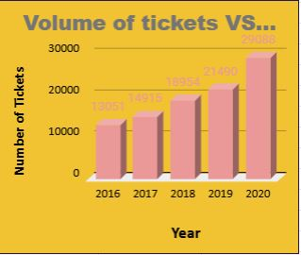
VOLUME OF TICKETS OVER TIME
INSIGHTS :
Steady growth in ticket volume over the past 5 years
A significant jump in 2020, possibly due to external factors like remote work shifts during the pandemic.
Year-over-year growth peaks at 35.5% in 2020, indicating a larger-than-usual spike.
Consider forecasting future volumes and planning resources accordingly

Slide 9
RECOMMENDATIONS :
Implement automation, self-service options, and proactive monitoring.
Adjust your staffing levels and ensure your team is well-trained and equipped to handle the increased workload.
Focus on root cause analysis and preventative measures to reduce recurring issues.
Plan for future growth through forecasting, resource scaling, and continuous improvement
Implement regular customer satisfaction (CSAT) surveys at the close of tickets to ensure you're maintaining high service quality. Monitoring CSAT scores can help identify areas where IT support is falling short.
Given the upward trend in ticket volume, try to forecast ticket demand for the next few years. Use historical data to predict trends, and plan staffing, resource allocation, and tool investments accordingly. This will allow you to scale proactively.

Slide 10
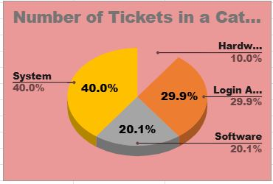
DISTRIBUTION OF TICKETS BY REQUEST CATEGORY
INSIGHTS :
System Issues represent the largest category and should be a focus for proactive monitoring and resource allocation.
Login Access issues make up a significant portion of tickets; implementing self-service tools can alleviate pressure.
Software Issues could be addressed with better user training and regular software updates
Hardware Issues remain a smaller category, but streamlining them will improve resolution efficiency.

Slide 11
RECOMMENDATIONS :
Proactive Monitoring & Alerts: Implement advanced monitoring tools to detect system failures, performance degradation, and network outages before users experience them. This will help in addressing issues before they lead to tickets.
Root Cause Analysis: Regularly perform root cause analysis on common system issues to identify recurring problems and fix them at the source. For example, investigate whether server overloads or system updates are causing frequent disruptions.
Self-Service Tools for Password Resets: Introduce a self-service password reset tool so users can reset their passwords and unlock their accounts without needing to contact support. This will reduce the volume of login-related tickets.
Login Issue Diagnostics: Provide users with clear, simple troubleshooting steps for common login issues, such as locked accounts or incorrect credentials. These can be included in a help center or FAQ section on the internal portal.
Regular Software Updates and Patches: Ensure that all software is up-to-date with the latest patches and updates. Automated deployment systems can be used to roll out updates across the organization to minimize issues caused by outdated software.

Slide 12
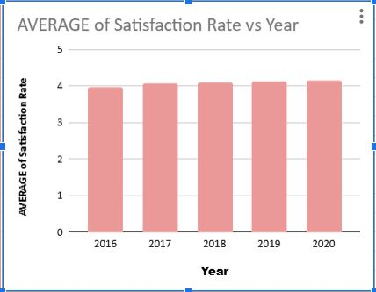
AVERAGE OF SATISFACTION RATE OVER TIME
INSIGHTS :
The steady increase in satisfaction from 2016 to 2020 indicates that IT support is improving and users are responding positively.
The consistency of the increase, particularly the slight rise in 2020, suggests that IT support team adapted well to increasing demand, potentially through better communication, improved tools, or more efficient handling of tickets.

Slide 13
RECOMMENDATIONS :
While satisfaction has improved over time, there is still room to boost scores further. Conduct post-ticket surveys or feedback forms to capture specific insights on what users feel could improve.
Implement a proactive communication strategy where users are regularly updated about the status of their open tickets. This can include automated status emails or messages on ticket progress.
Focus on reducing the resolution time for high-priority tickets, especially for system outages, critical application failures, or login/access issues.
Integrate AI chatbots or automated workflows that can handle simple, repetitive tasks like responding to common questions, processing password resets, or suggesting troubleshooting steps for frequent issues.
Continuously train IT support staff on the latest technologies, tools, and best practices in customer service.
After a ticket is resolved, conduct a follow-up survey or email to ensure users are satisfied with the solution and the overall support process

Slide 14
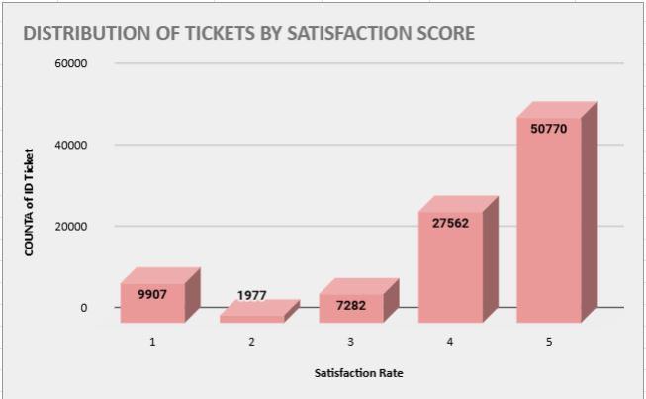
DISTRIBUTION OF TICKETS BY SATISFACTION SCORE
INSIGHTS :
High Satisfaction: The majority of tickets are rated highly (scores 4 and 5), indicating that IT support is generally meeting or exceeding expectations.
Low Satisfaction Focus: However, a notable portion of tickets (around 15.6%) are rated with low satisfaction scores (1-3), indicating areas where support could be improved. This group represents an opportunity to analyze and improve the underlying causes of dissatisfaction or neutrality

Slide 15
RECOMMENDATIONS :
Conduct a detailed root cause analysis of the tickets with scores 1 and 2 to identify recurring issues or patterns (e.g., unresolved technical issues, long wait times, poor communication).
Implement a follow-up process for tickets with scores 1 and 2, either via email or phone, to better understand the user's concerns and offer further assistance.
For tickets rated with score 1, establish an escalation protocol to quickly move these issues to senior support staff or a specialized team for faster resolution.
Review tickets rated with score 3 to identify whether the resolution was partially effective but not outstanding.
Analyze the tickets with score 5 to identify common best practices that lead to high satisfaction. This could include quick resolution times, clear communication, or specific actions taken by support staff.
Recognize and reward support staff who consistently receive high ratings (scores 4 and 5).

Slide 16
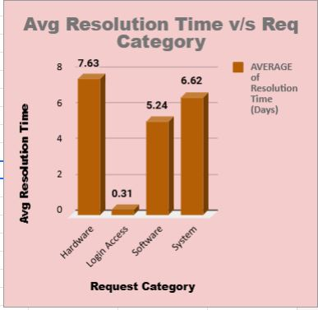
AVG RESOLUTION TIME BY REQUEST CATEGORY
INSIGHTS :
The login access category is already highly efficient with consistent and lower resolution times.
Hardware and system request resolution times remain stable but may benefit from further optimizations to reduce the average time for these more complex issues.
The software category shows slight fluctuations, with a need to focus on investigating Qtr 4's slight increase in resolution time.

Slide 17
RECOMMENDATIONS :
Hardware Issues: Focus on automation, better resource allocation, and analyzing peak times to reduce the resolution time further.
Login Access: Continue leveraging self-service options to maintain the extremely lower resolution time.
Software and System Issues: Implement knowledge management, predictive maintenance, and remote diagnostic tools to optimize resolution times and reduce fluctuations
Cross-Category Improvements: Invest in employee training, collaboration, and advanced IT tools to streamline ticket resolution across all categories.
Establish clear KPIs (Key Performance Indicators) for resolution times across all request categories and track performance on a monthly or quarterly basis.
Provide ongoing training programs for support staff to enhance troubleshooting skills, especially in areas where resolution times are higher (e.g., hardware, software, system).

Slide 18
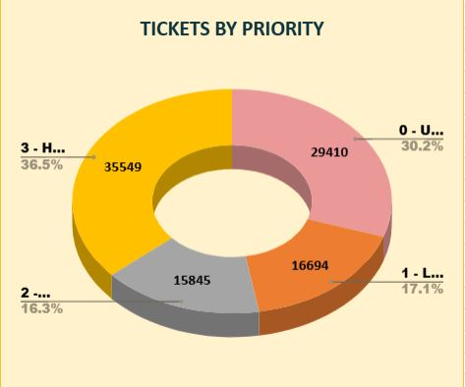
TICKETS BY PRIORITY
INSIGHTS
The highest number of tickets falls under High priority. This indicates that a significant portion of the issues being reported is considered critical or urgent, which may require immediate attention or have a larger impact on users or business operations.
The large number of unassigned tickets is concerning. Unassigned tickets could indicate a backlog, inefficiency in ticket triage, or a lack of capacity to allocate issues to the right support teams.
The medium-priority tickets fall in between high and low, making up a fairly large portion of the ticket pool. These may represent issues that need attention but are not urgent, and resolving them in a timely manner is important to prevent them from escalating into high-priority tickets.

Slide 19
RECOMMENDATIONS :
High-priority tickets: Ensure quick handling and allocate sufficient resources to handle the large volume.
Unassigned tickets: Implement automated ticket routing and review the triage process to prevent tickets from being unassigned for long periods.
Low-priority tickets: Streamline their resolution through batch processing, self-service solutions, and clear SLAs.
Medium-priority tickets: Prioritize based on urgency and ensure proper workflows for efficient resolution.
Implement automation tools for common tasks like ticket categorization, routing, and status updates to reduce manual work and speed up ticket processing.
Provide regular training for support agents to handle tickets of varying priority effectively. Also, consider cross-training agents so they can address a wider variety of issues, reducing the need for ticket escalation.

Slide 20
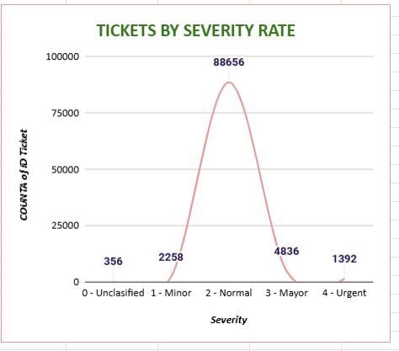
TICKETS BY SEVERITY RATE
INSIGHTS :
The majority of tickets are categorized as Normal severity. This indicates that the bulk of the issues are considered regular, non-critical problems that still require attention, but not necessarily immediately.
There are a smaller number of Minor severity tickets. These typically represent issues that don't have a significant impact on operations or users, but they still need to be addressed.
Urgent severity tickets represent a relatively smaller number of tickets, but these are likely critical problems that need immediate attention, as they can have a substantial impact on users or operations.

Slide 21
RECOMMENDATIONS :
Since Normal severity tickets make up the majority of your tickets, optimize processes for handling them to prevent delays. Implement systems that allow these tickets to be handled in batches or through automation for common issues.
Major and urgent tickets should have clear prioritization protocols in place. These tickets should be handled immediately by the appropriate teams or agents to minimize impact.
Handle Minor severity tickets in bulk or via self-service solutions (e.g., FAQs, automated troubleshooting guides). If many minor issues are similar in nature, consider grouping them together for quicker resolution.
Use automation to close out or resolve minor tickets where possible, particularly for recurring problems that don’t require in-depth troubleshooting.
Unclassified tickets should be reviewed immediately and assigned a severity classification. Create a process for quickly reviewing and categorizing unclassified tickets to avoid delays in resolution.
Allocate resources according to ticket severity. For example, high-priority teams should be dedicated to Urgent and Major severity tickets, while Normal and Minor tickets could be handled by other teams or through automated systems.

Slide 22
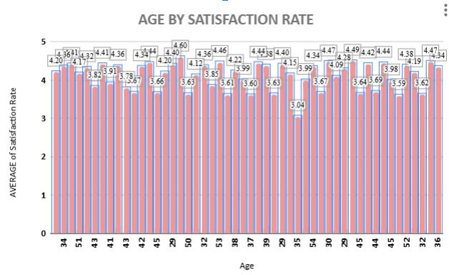
AGE BY SATISFACTION RATE
INSIGHTS :
The satisfaction rate increases in (45 – 48) age group, indicating that users in their late 40s may be experiencing a higher level of satisfaction with the service. This could be related to factors such as more experience or better expectations alignment.
These age groups (34 – 36) experience the lowest satisfaction, particularly age 34, which stands out with a significant dip in satisfaction. There might be factors affecting this age group, like expectations, service delivery, or a specific issue that needs to be addressed.
The satisfaction rates for 28 (4.26) and 29 (4.14) are relatively high compared to other age groups, indicating a positive experience in younger adults.

Slide 23
RECOMMENDATIONS :
The low satisfaction rate in the 34 age group and slightly lower satisfaction in 36 could suggest underlying issues. Consider conducting more in-depth feedback surveys for this demographic to understand the specific causes of dissatisfaction.
The mid-30s to early 40s (ages 35-44) show a moderate level of satisfaction. This could be due to increased expectations or more complex needs. Offering targeted support or personalized experiences for this group may help.
Given that users in the 45-48 age group show high satisfaction, consider analyzing their feedback to identify best practices. For example, look for common issues that are being resolved well or any areas of service that align better with their needs.
Younger Age Groups (28-29) are experiencing relatively high satisfaction, so maintaining the service level and engagement with this demographic could help maintain these positive trends.
Middle-Aged Adults (34-36 and 35-44) report lower satisfaction, especially at age 34, suggesting a potential need for deeper investigation into the factors affecting this group.
Older Age Groups (45-48) report the highest satisfaction, offering valuable insights into what works well for this demographic that could be adapted to other groups

Slide 24
VOLUME OF TICKETS V/S AVERAGE OF RESOLUTION TIME
INSIGHTS :
The ticket volume fluctuates monthly, with January having the lowest ticket volume (7,242) and October and August having the highest volumes (8,495 and 8,489, respectively).
The average satisfaction rate remains relatively stable throughout the year, fluctuating between 4.07 and 4.15.
In January, when ticket volume is at its lowest, the satisfaction rate is 4.15, which is the highest of the year.
While satisfaction remains high, there is a slight dip in satisfaction rates during the peak months of February, March, and October, where the average rating drops to 4.07

Slide 25
RECOMMENDATIONS :
Ticket Volume Management: Increased ticket volume during August to October doesn't seem to dramatically affect satisfaction, but it does cause slight drops in ratings. Managing ticket volume during these peak months with extra resources or automation could prevent this.
Maintain Quality During Low Volume: In months like January, when ticket volume is low, satisfaction is higher, suggesting that maintaining a higher level of personalized support in lower volume periods is beneficial.
Satisfaction Consistency: Overall satisfaction is stable, which is a positive sign of efficient operations, but further investigation into specific dips during certain months can help refine processes and avoid any impact on customer experience.
Use Automation Smartly: To maintain high satisfaction during peak months, leveraging automation tools for common requests can help balance the increased ticket volume and maintain timely responses.

Slide 26
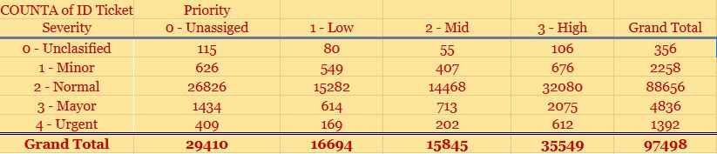
Ticket Management Software
INSIGHTS :
From the above pivot table, it can be observed that:
Many of the tickets are still unassigned to any of the agents.
The tickets with the Urgent Severity, are lying unassigned which may directly affect our satisfaction rates.
It also may result in violation of SLA(Service Level Agreements)
Unaddressed issue may escalate, requiring more resources and time to fix it.
It can also lead to prolonged service interruptions and affecting business operations.

Slide 27
RECOMMENDATIONS :
Tickets need to assigned immediately based on their Severity type.
Use ticketing tools to assign high-severity tickets automatically to available agents.
Always ensure that high-severity tickets are always addressed first.
Set up alerts about the unassigned ticket to any senior managers.
Allocate senior agents to work on high severity issues.

Slide 28
KEY INSIGHTS DERIVED FROM THE ANALYSIS
The increasing ticket volume suggests that the business is growing or that users are facing more issues that need attention. This growth can lead to resource strain, so scalable solutions like automation or staffing adjustments are essential.
The frequency of system-related issues and login access points to a need for improving system stability and user access points. For hardware issues, proactive maintenance or better troubleshooting resources can reduce the number of tickets raised
The improvement in satisfaction indicates that the support team is effectively addressing user issues. However, maintaining or boosting satisfaction further will require continuous monitoring and addressing any emerging service gaps.
A significant number of tickets are rated 4 (27,562) and 5 (50,770), showing overall positive experiences with support. However, there’s still a sizeable group rating tickets as 1 or 2 (12,884 combined), indicating areas for improvement.
Login access issues have the shortest resolution time (0.31 hours across all quarters), while hardware issues have the longest resolution time (7.55 hours in Q4)
The majority of tickets are categorized as unassigned (29,410), with a significant portion marked low priority (16,694) and high priority tickets (35,549) making up a smaller portion

Slide 29
Specific Recommendations
Always ensure that high-severity tickets are addressed first.
Set up alerts about the unassigned ticket to any senior managers.
We can also pair high-performing agents with those needing improvement.
Assign senior agents to guide newer or struggling agents.
Identify the areas in which the agent is underperforming, such as communication issues or lack of technical knowledge/skills.
Check if the agent is using proper troubleshooting steps to resolve the query and train the agent with the software and troubleshooting methods.
Speed up ticket resolution times by providing ready access to solution for common issues
Can handle increasing ticket volumes by hiring more agents and providing necessary trainings
Timely resolutions will enhance satisfaction ratings.

Slide 30
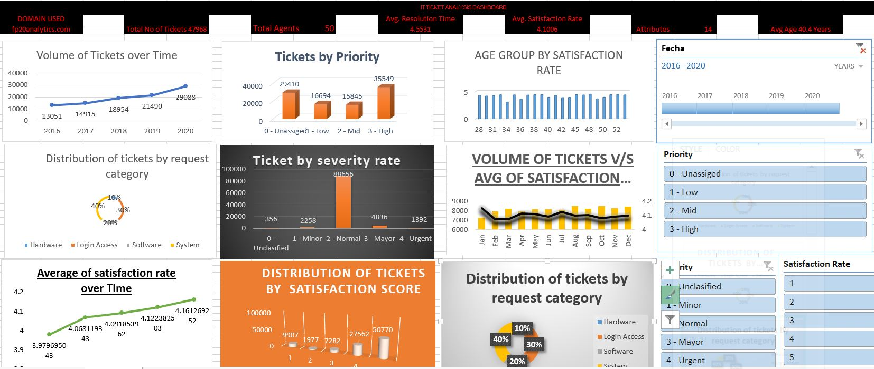
DASHBOARD

Slide 31
CONCLUSION
INSIGHTS
Ticket volume Trends :
Peak Times : High ticket volumes observed during specific periods such as system updates
Recurring Issues : Login issues and software related repeated issues can be provided with documented solutions
Resolution Time :
Delays in resolution : Average resolution time for critical tickets is above SLA thresholds
Bottlenecks identified : Specific agents causing delays (lack of skills or missing expertise)
Categorization and Prioritization :
Tickets are often miscategorized, leading to delays in routing and resolution
User Feedback :
Poor satisfaction ratings linked to delayed responses and lack of follow-up communication
Resource Allocation :
Understaffing during peak periods leading to backlog accumulation

Slide 32
RECOMMENDATIONS
Automation and Self-Service : Implement self-service portals and automated workflows for common issues
Process Improvements : Streamline ticket routing processes to minimize misclassification
Resource Optimization : Adjusting staffing levels based on historical volume trends, train junior agents to handle medium-complex tickets to reduce dependency on senior agents
Enhanced Monitoring and Analytics : Regularly review SLA performance and resolution time trends
Knowledge Base Development : Expand and regularly update guides, documents containing recurring issues to reduce ticket inflow

Slide 33


